Slide 1
Les Manuscripts du
Nouveau Testament
Dr. David Trobisch
www.Trobisch.com
David.Trobisch@gmail.com

Slide 2
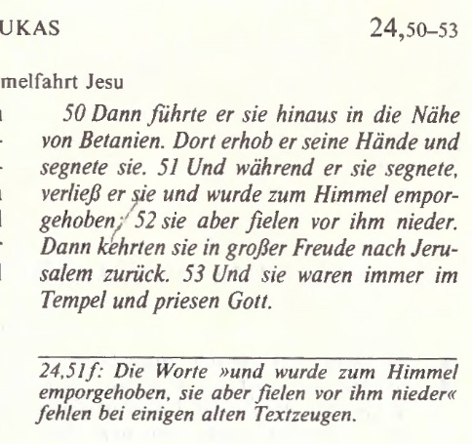
Einheitsübersetzung Lukas 24

Slide 3
Media\Erasmus Lk24 BTS1519.doc

Slide 4
Minuscule 2 (12th century) Matth 16
Aland, Text of the NT, 15

Slide 5
A 02 (Alexandrinus)

Slide 6
D 05 (Bezae Cantabrigiensis)

Slide 7
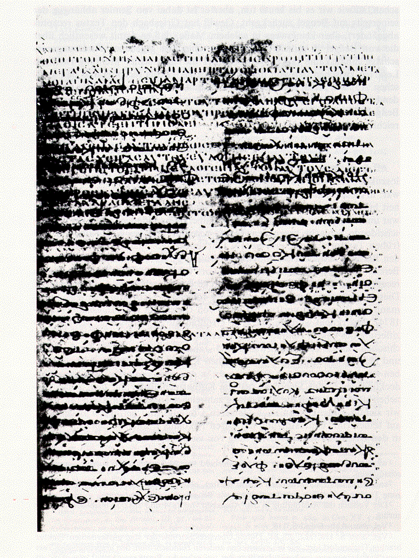
C 04
(Ephraemi Rescriptus)

Slide 8
Codex Sinaiticus (ℵ 01)

Slide 9
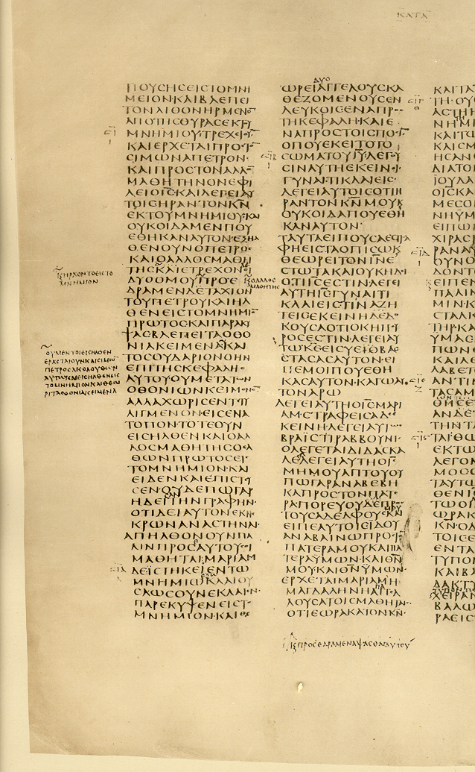
ℵ 01 John 20

Slide 10
Scriptio Continua
GODISNOWHERE
GOD IS NOW HERE
GOD IS NOWHERE

Slide 11
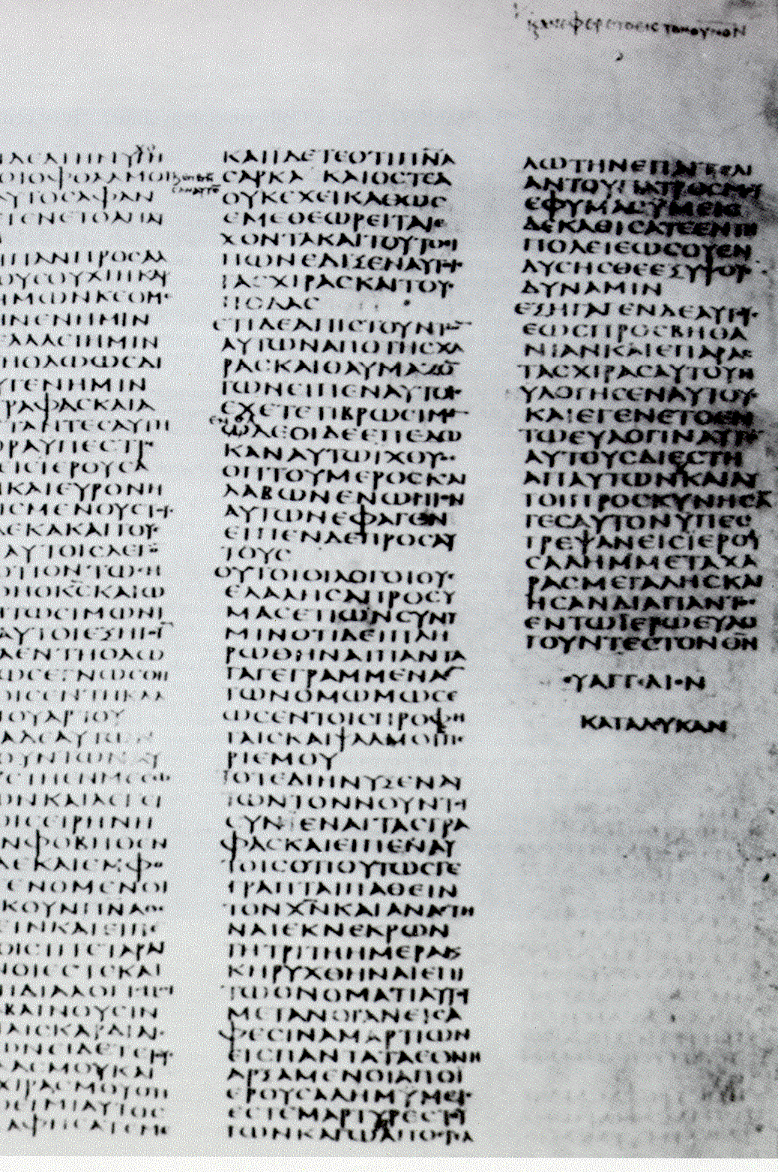
ℵ 01 (Sinaiticus)

Slide 12

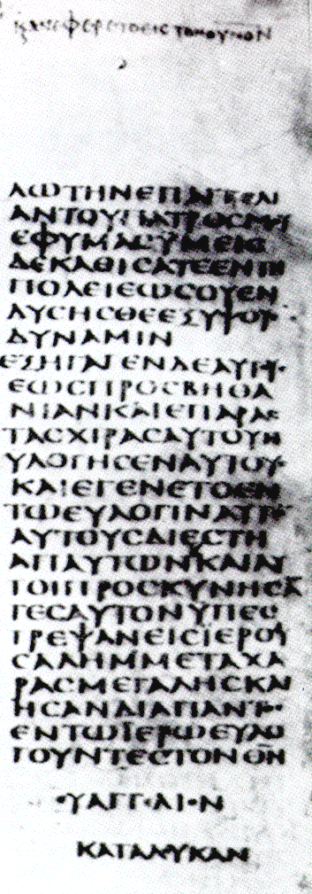

ℵ 01 Ascension
ΚΑΙ ΑΝΕΦΕΡΕΤΟ ΕΙΣ ΤΟΝ ΟΥΝΟΝ

Slide 13
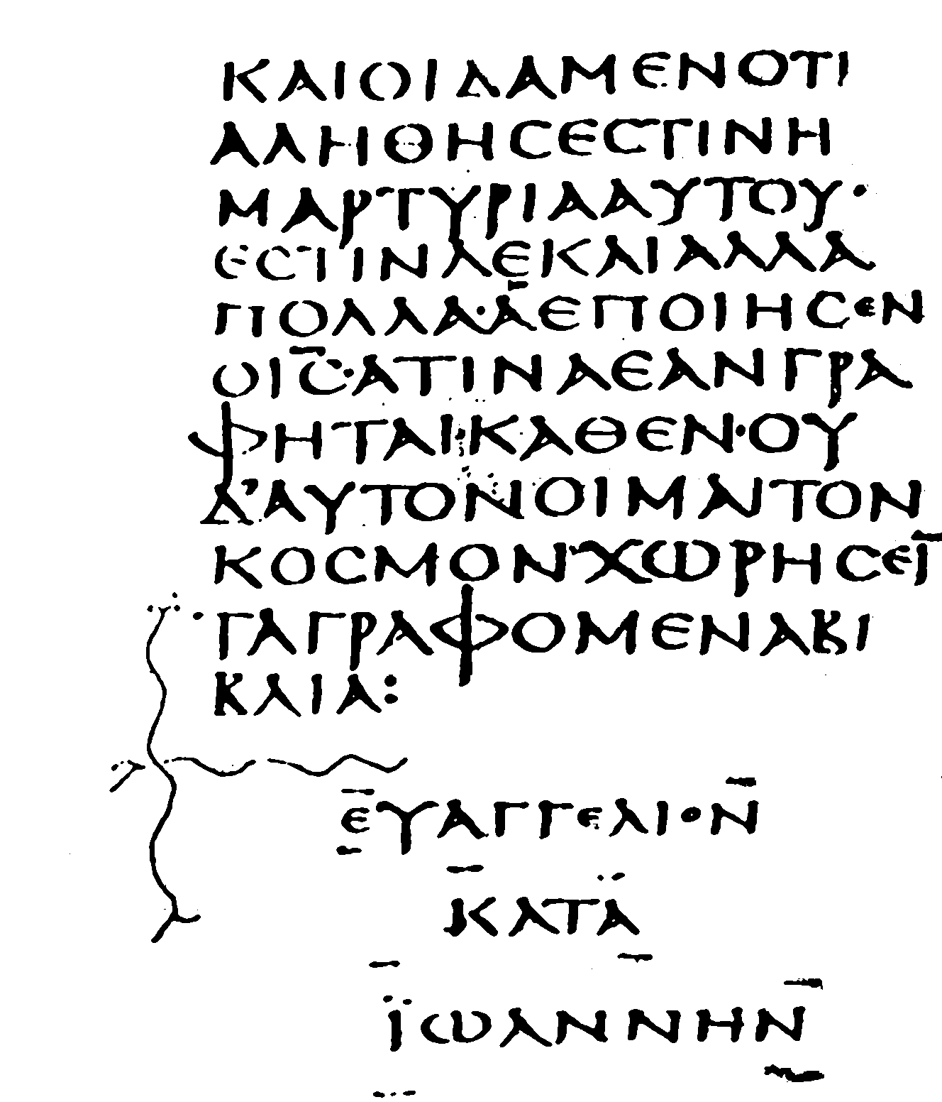
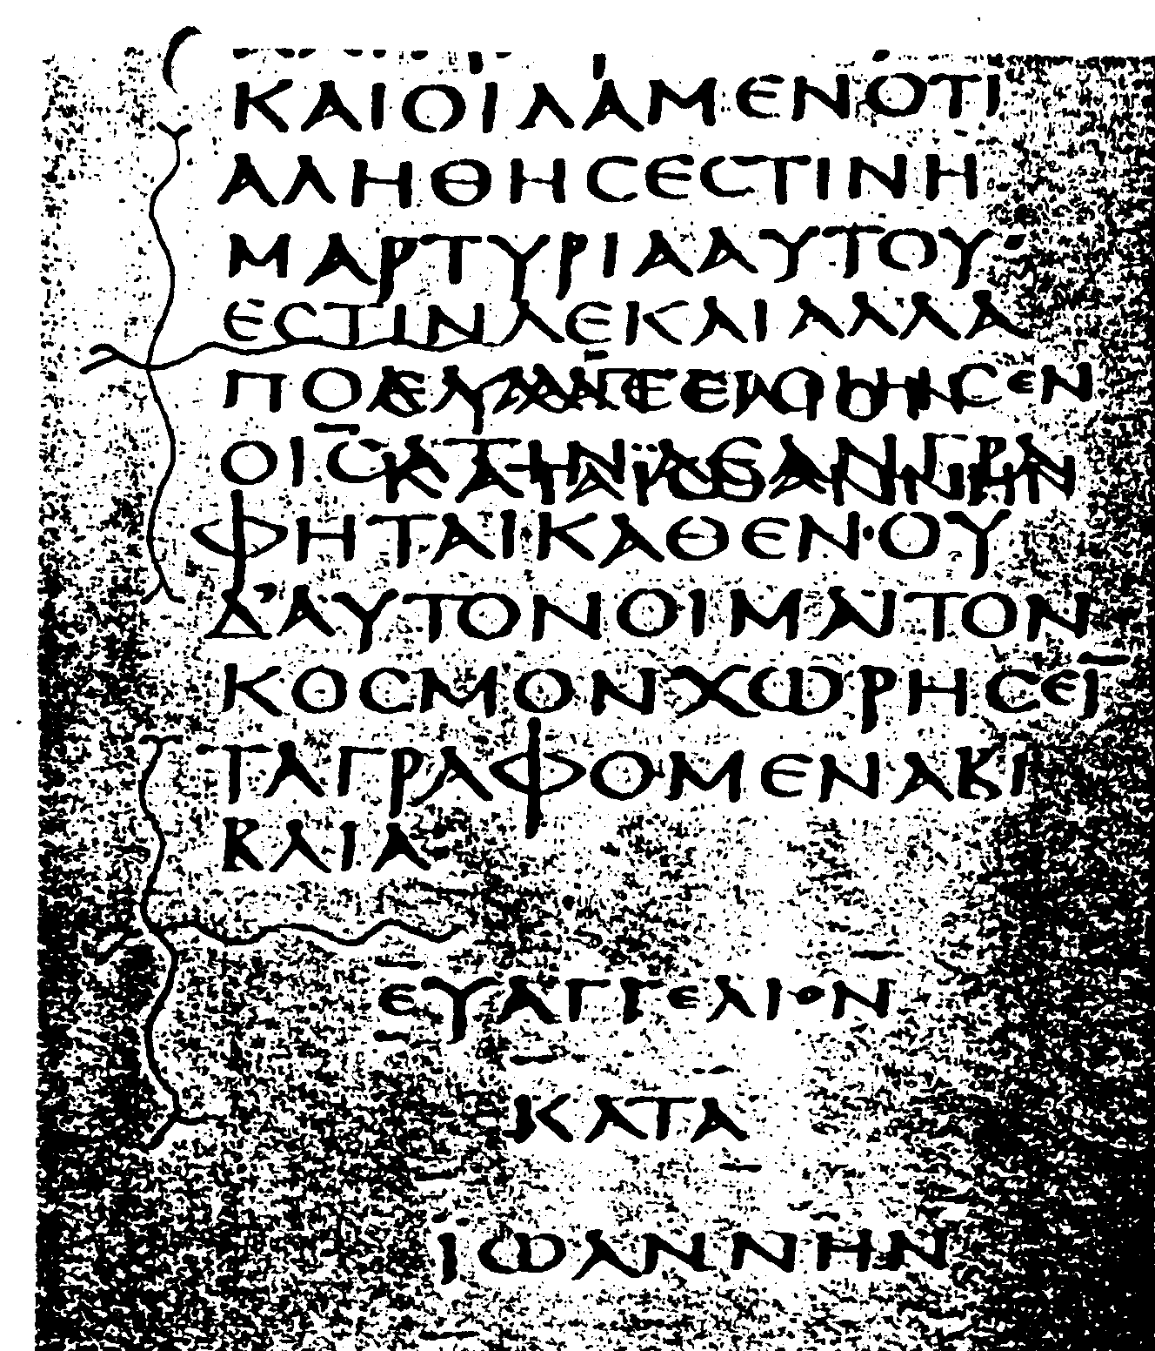
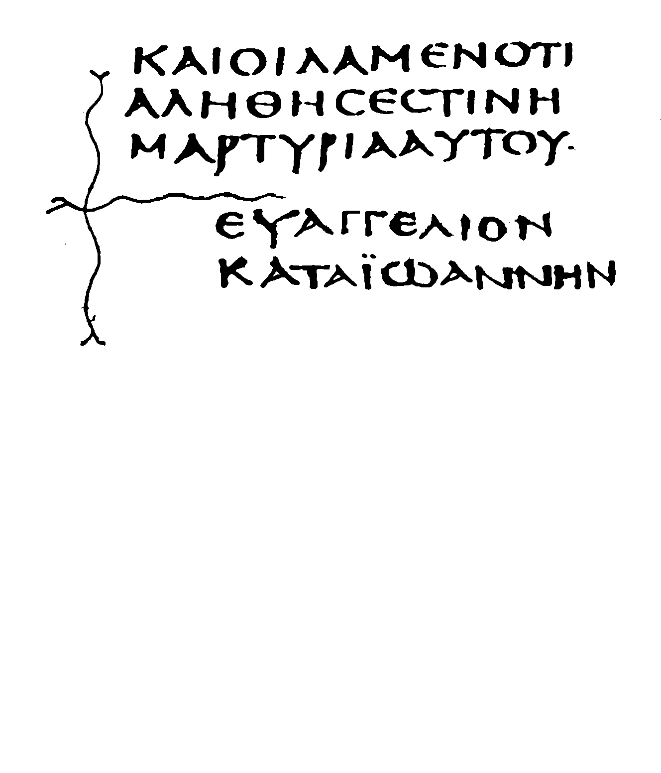
ℵ 01
John 21:24f
Jésus a fait encore beaucoup d'autres choses; si on les écrivait en détail, je ne pense pas que le monde même pourrait contenir les livres qu'on écrirait.

Slide 14
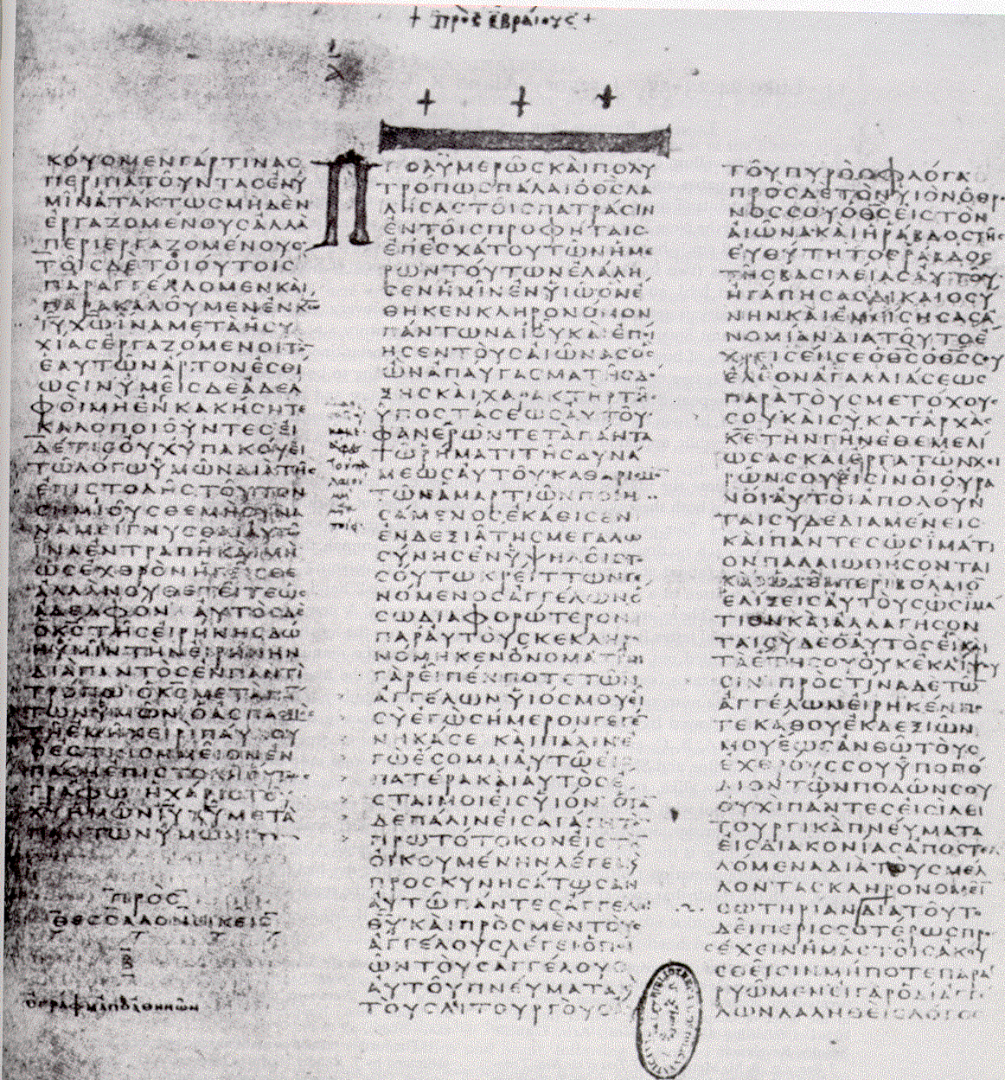
B 03 Vaticanus

Slide 15
Bodmer Papyrus XXIV, Page 19 (ΙΘ), Late 3rd–4th century, GC.MS.000170.4
[ΛΒ= Ps 32]
Notes:
The five leaves that are displayed in this exhibit preserve ten consecutive
pages from P. Bodmer XXIV, the most substantial papyrus text of the
Psalms found thus far. This codex was made from forty-one sheets of
papyrus folded into a single thick quire to form 164 pages. On the first
and third leaves (shown on the following spread) the page numbers
written at the top in antiquity are still visible, identifying these sheets as
pages 19–28 (in Greek numerals, ΙΘ=19, Κ=20, and ΚΔ=24).
Despite its battered state, this codex is the earliest copy of the Psalter
of which more than scraps remain (ninety-eight of the original 164
pages survive, a remarkable percentage by comparison with other early
witnesses to Greek Psalms).

Slide 16
POxy 4499
Revelation of John
P¹¹⁵ ca. 300 CE
Revelation of John
P¹¹⁵ ca. 300 CE
Notes:
http://www.csad.ox.ac.uk/POxy/beast616.htm
One feature of particular interest is the number that this papyrus assigns to the Beast: 616, rather than the usual 666. (665 is also found.) We knew that this variant existed: Irenaeus cites (and refutes) it. But this is the earliest instance that has so far been found. The number — chi, iota, stigma (hexakosiai deka hex) — is in the third line of the fragment shown below.

Slide 17
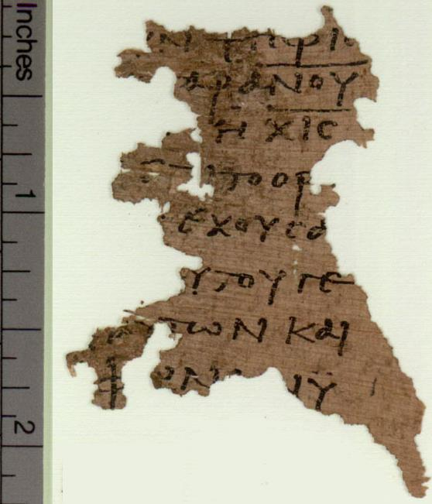
ΥΝΨΗΦΙΣ
___
ΑΡΑΝΟΥ
___
ΗΧΙΣ
ΕΠΙΤΟΟΡ
ΕΧΟΥΣΑ
ΥΤΟΥΓΕ
ΑΥΤΩΝΚΑΙ
ΦΩΝΗΝΥ
POxy 4499
Revelation of John
P¹¹⁵ ca. 300 CE
Rev 13:18ff

Slide 18
Write the number 666 in Greek:
Letter | Value | Letter | Value | Letter | Value
Α | 1 | Ι | 10 | Ρ | 100
Β | 2 | Κ | 20 | Σ | 200
Γ | 3 | Λ | 30 | Τ | 300
Δ | 4 | Μ | 40 | Υ | 400
Ε | 5 | Ν | 50 | Φ | 500
ϝ or ϛ or C | 6 | Ξ | 60 | Χ | 600
Ζ | 7 | Ο | 70 | Ψ | 700
Η | 8 | Π | 80 | Ω | 800
θ | 9 | ϟ | 90 | Ϡ | 900
___
XIC = is not 666 !

Slide 19
Four Manuscripts of the Christian Bible

Slide 20
Evaluating The Evidence

Slide 21
The Two Text-critical
Rules of the Thumb
lectio brevior potior
  the shorter reading is the better reading
lectio difficilior potior
  the more difficult reading is the better reading

Slide 22
The shorter reading is the better reading
Lk 24:52-53
And they returned to Jerusalem with great joy, and were continually in the temple
Variants:
praising God
blessing God (New Revised Standard Version)
praising and blessing God (King James Version)

Slide 23
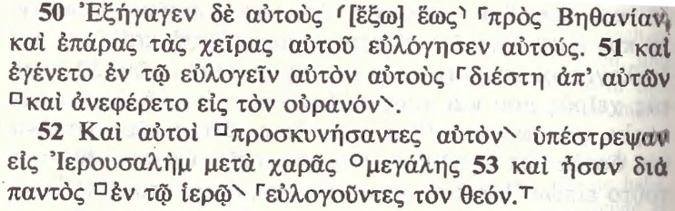
Lectio difficilior

Slide 24
Error?

Slide 25
Les Manuscripts du
Nouveau Testament
Dr. David Trobisch
www.Trobisch.com
David.Trobisch@gmail.com

